Slide 1
Image Processing
Subject : Banknote Recognition
Name: Eren
Surname: Alpar
URL: http://enadream.com

Slide 2
How is an Algorithm will I use to detect banknote ?
Step 1: Detect biggest rectangular shape from webcam.
Step 2: Re-rotate and flat this rectangular shape and save as png.
Step 3: Check histogram of that png to determine which banknote can be.
Step 4: Try to recognize the money according to histogram probability order.

Slide 3
Step 1
Two filters combined to detect money’s position in the image. (Blue filter + Gray filter)
Apply cv2.findContours function to the filtered image.
Take biggest rectangular shape from contours.
Create a black white mask according to 4 coordinates and apply to original image.

Slide 4
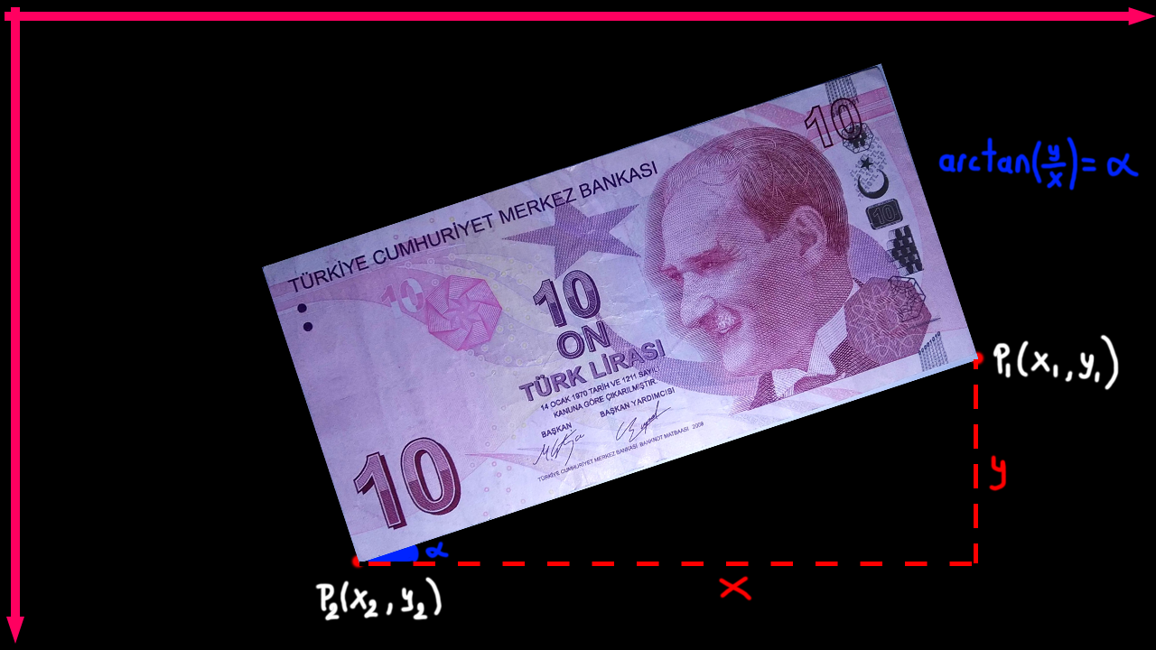
Step 2
Find width coordinates of the rectangular shape.
Calculate slope of two width coordinates
Find slope in degrees (using np.arctan(slope) )
Rotate image based on angle found
Apply cv2.findContours again and save boundingrect of the contour as banknote.png

Slide 5
Step 3
Calculate histograms of currently known currency images.
Compare these histograms with unknown image’s histogram.
Sort compared histogram values.

Slide 6
Step 4
Take the money type with the highest histogram similarity rate.
Resize the known money image to unknown money image size.
Convert both images to grayscale.
Subtract two pictures pixel by pixel.
Convert negative result to positive.
Sum all pixel differences and divide by width * height. (arithmetic mean of difference)
If the average smaller than difference threshold print money’s amount. Else go to the next money image.

Slide 7
